Slide 1







How to inspire young people to join the ICT labor market: Ativar Portugal & Do IT, GIRLS! Programs
Vânia Neto
Education & Citizenship Lead

Slide 2


+350M€ invested in Portugal
Education +200M€
In free software
+15M€
CSR programs
+150M€
Companies Modernization
Headquarters
investment
+20M€
Others
+30M€

Slide 3
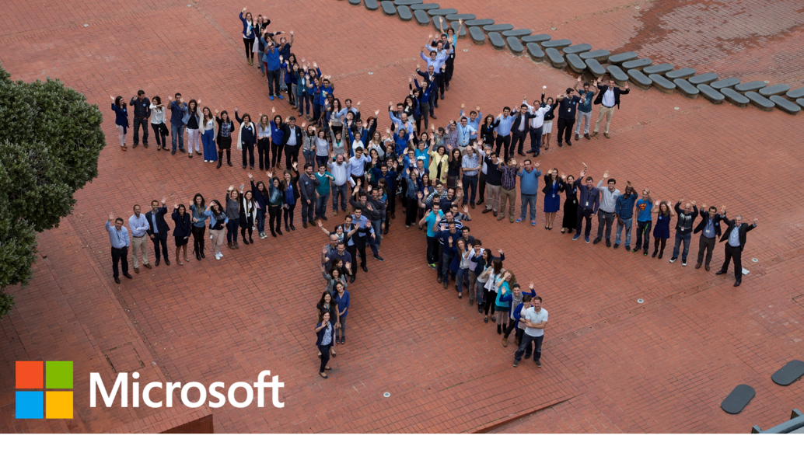


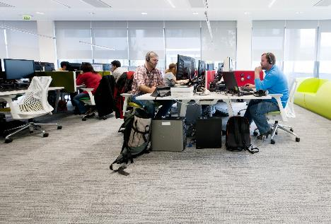
Partner Network
+3k
Microsoft Portugal
+400 workers
230 people
One of the 7 global centers Serving Europe and Africa
Cloud Technology
+ 45 k jobs
+ 5 kM€ billing
1:10€ income Microsoft/Partners
+25% IT industry
+4x sector growth

Slide 4
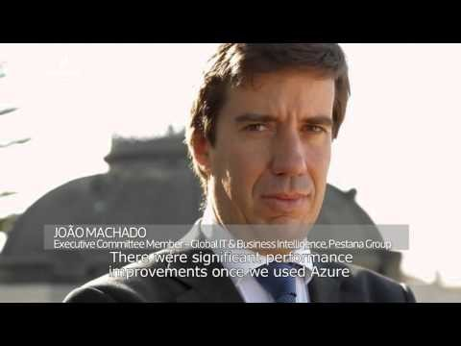

Slide 5
What is our vision for 2020?
Portugal in the Center of Europe in IT
50.000 jobs created in IT
IT as growth engine: 3->5% GDP
Notes:
Portugal reconhecido como pólo de inovação e competência mundial e Europeu em TIs
+50.000 novos empregos TI criados em Portugal (10.000 em Microsoft) até 2017; 0% desemprego setor
TIs como motor crescimento económico em Portugal

Slide 6

Where is the oppportunity?
Portugal
5,000+
Job offers in IT not fullfilled in 2015
Europa
900,000
Job offers in IT not fullfilled until 2017
Dados: Janeiro 2015
Notes:
Taxa de desemprego
http://observador.pt/2015/03/02/taxa-de-desemprego-de-112-em-janeiro-na-zona-euro-a-menor-desde-abril-de-2012/

Slide 7
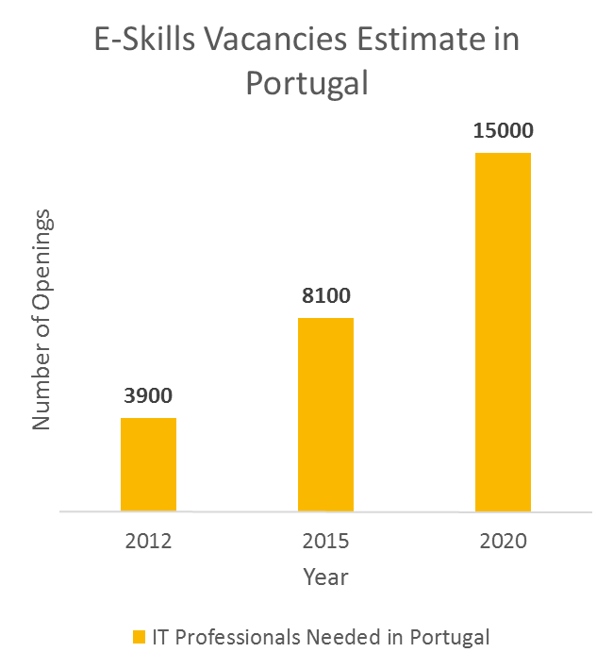
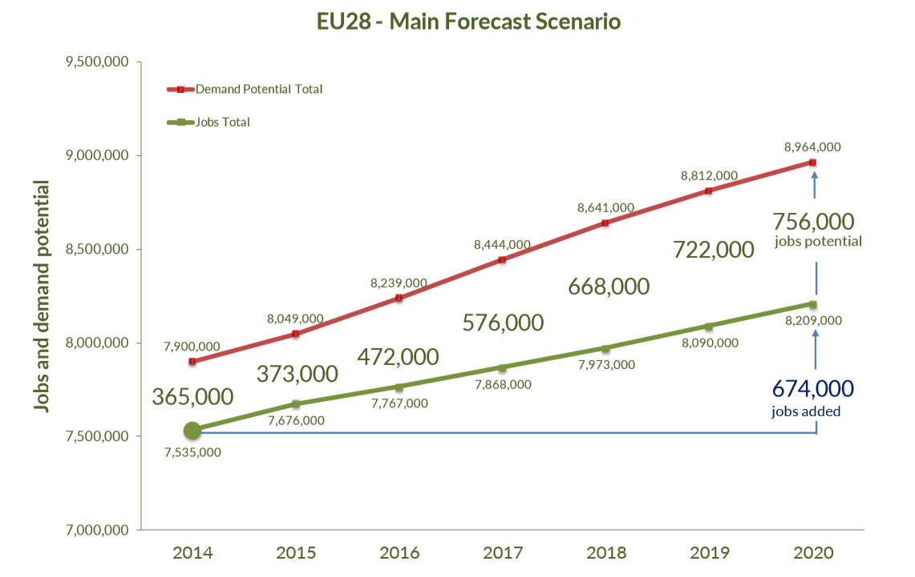
Digital Skills GAP
Gap of resources and potential jobs
Notes:
Em 2015 estimavam-se 8.100 vagas para profissionais de TI em Portugal, subindo esse número para 15.000 em 2020 (“E-Skills in Europe”, 2014)
Um estudo da Jobbox de 2015 concluiu que os Engenheiros de TI e Programadores portugueses têm pleno emprego em Portugal.
(2º gráfico) A procura potencial de profissionais de IT em 2015 excedeu o número de vagas em 373 mil lugares. Em 2020, a procura potencial acrescerá 756 mil lugares (“E-Skills in Europe”, 2014)

Slide 8



Microsoft: Passport for a job
Como pode a Microsoft ajudar?
World reference
Quality seal
SCALE
150,000 partners in Europe
3,500 in Portugal
VACANCIES
~ 50% Microsoft technology
*
SALARIES
50% above average*
*System analist

Slide 9
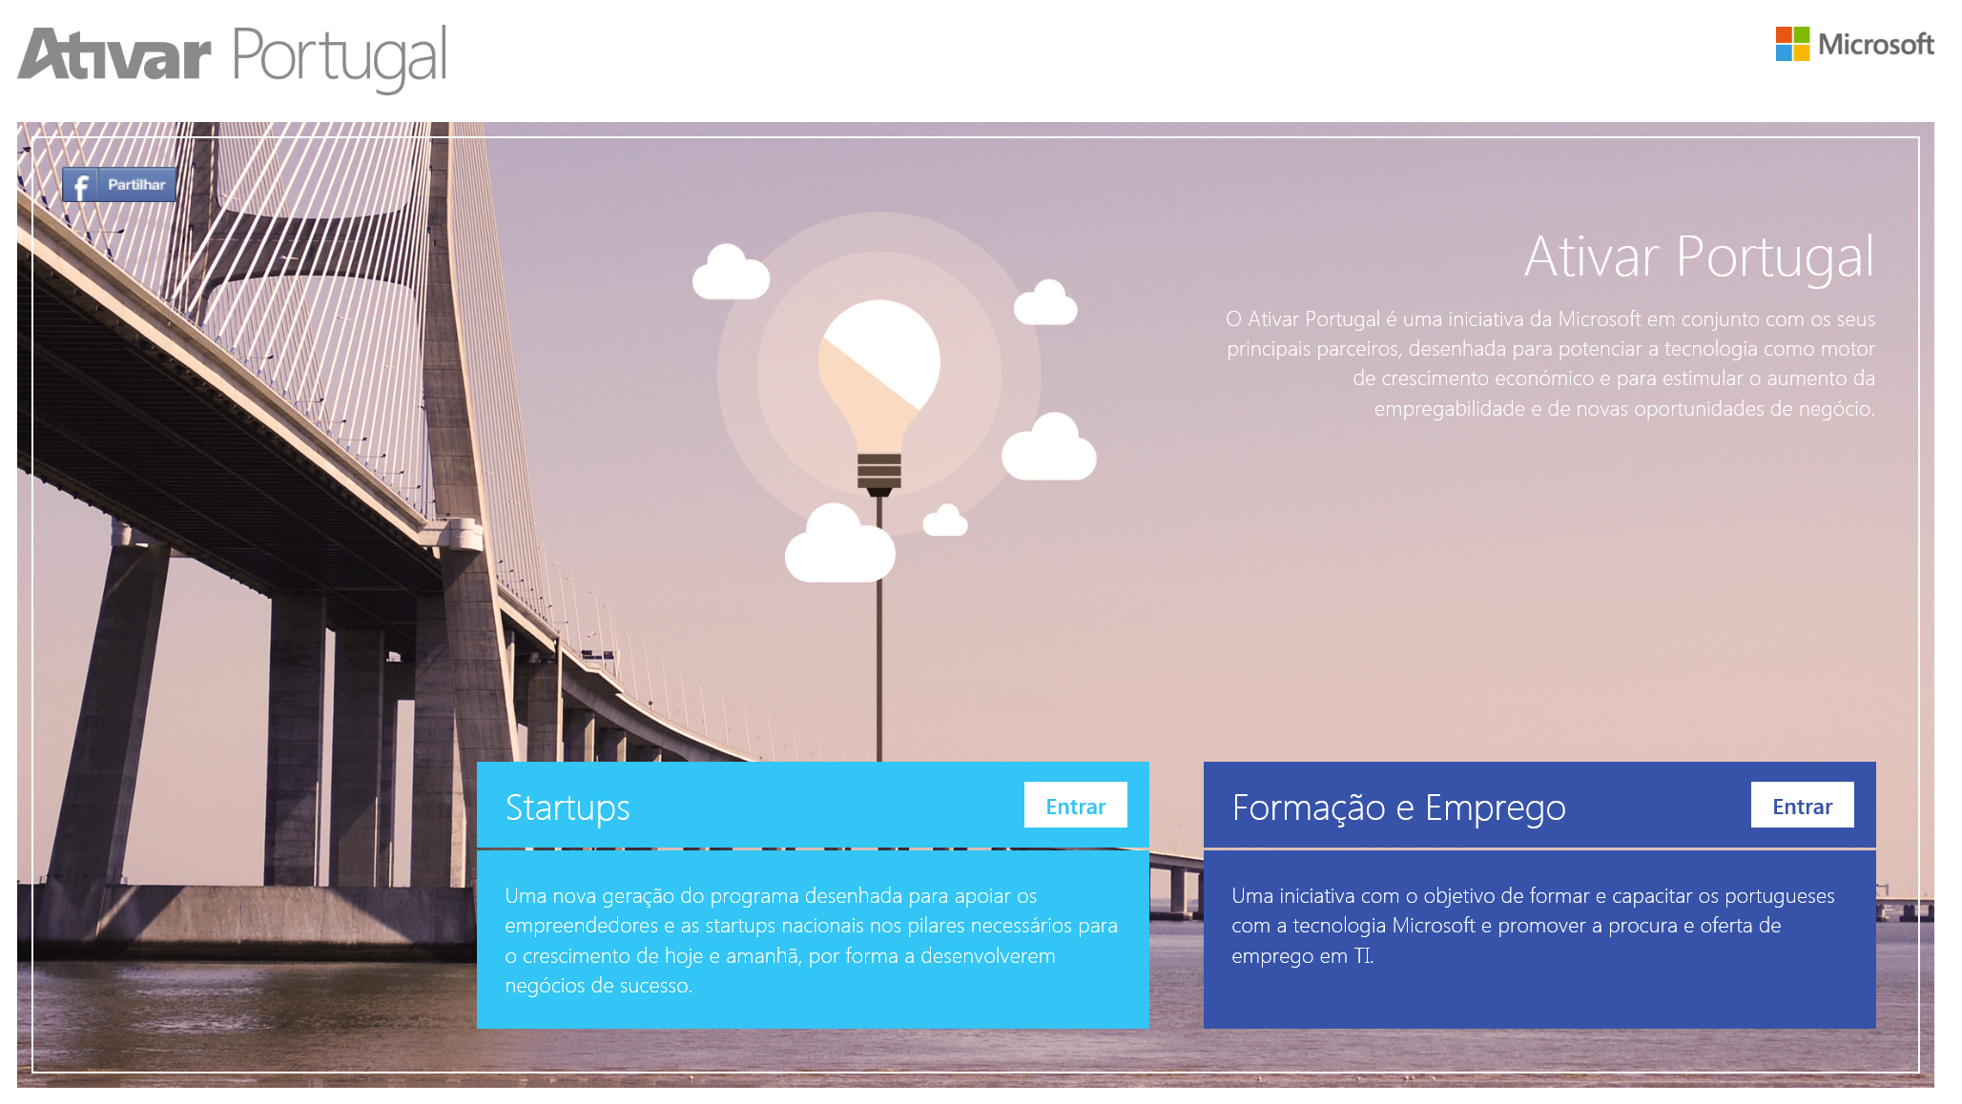

Slide 10
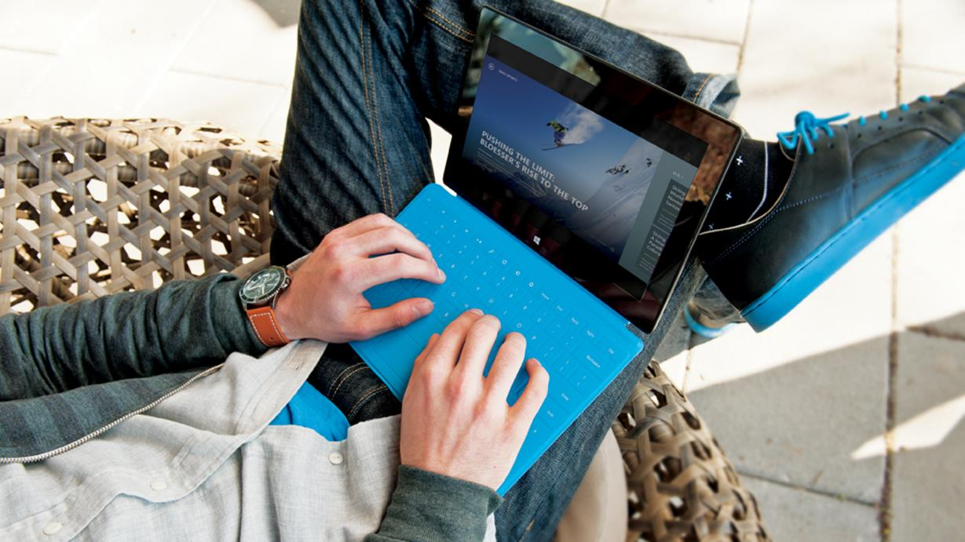

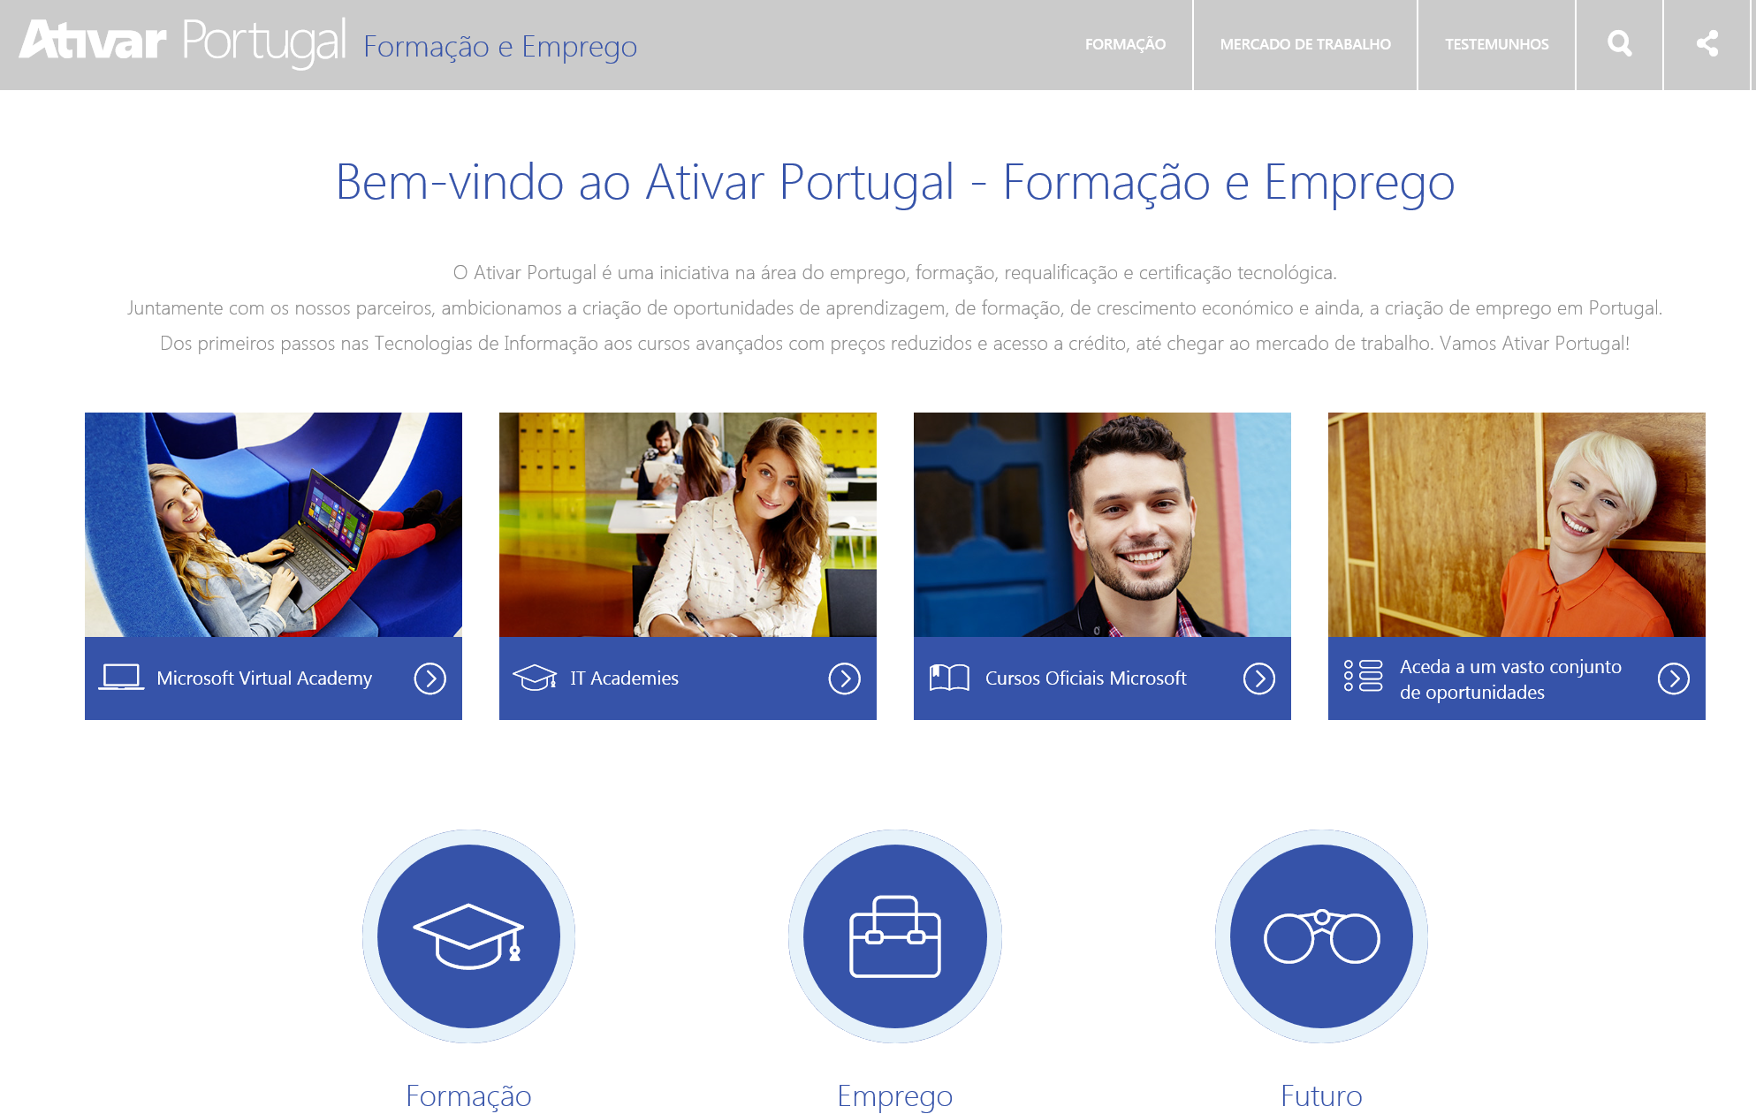
Training and jobs
In Information Technologies
+ 4k Candidates
+ 650 Opportunities
+ 240 Companies
+1.500 Contacts made

Slide 11





Training and jobs | Digital Skills
Prepare the Future today
Job market
(Public and Private)
Unemployed
Higher Education
Secondary and vocational education
Skills
There is no Inovation in the Digital Era without Digital Skills

Slide 12
Startups

Slide 13
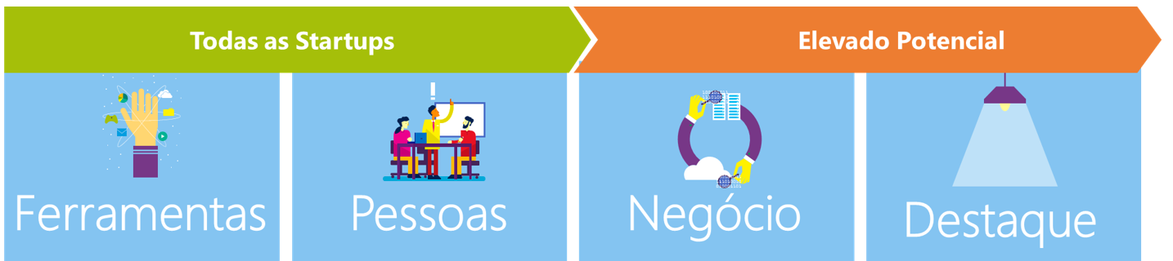
Notes:
Vision:
Scaleups Source:
Data Sources: Startup Europe Partnership (SEP) Monitor Report, November 2015 “Portugal Rising: Mapping ICT Scaleups”

Slide 14


























































Ativar Portugal success: big ecossystem
Official Partners
Microsoft Customers
Marketplace Partners & Supporters
Notes:
So what’s unique? This is about an entire ecosystem coming together to bring the best of the best to help startups succeed.
Recognise and call out the official partners supporting the initiative and also thank all of our customers for taking part in the first of our speed dating sessions with startups.

Slide 15

Do IT, Girls!
project

Slide 16


Slide 17
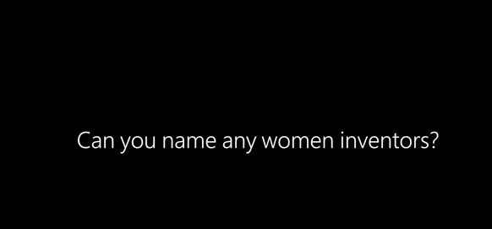
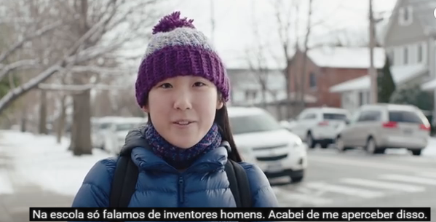
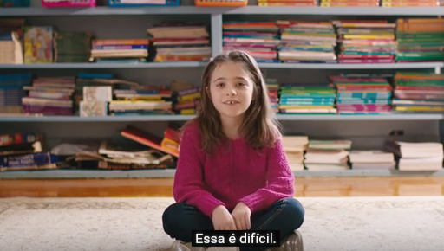
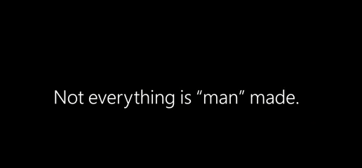
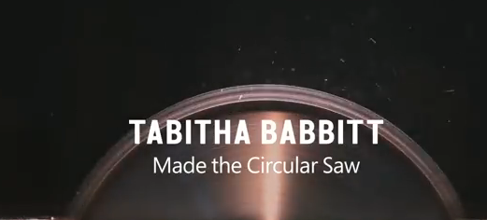

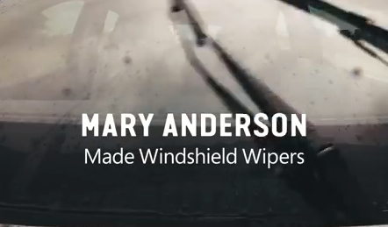
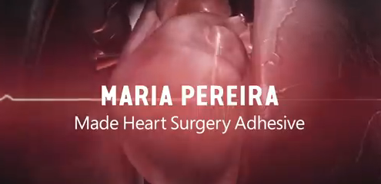
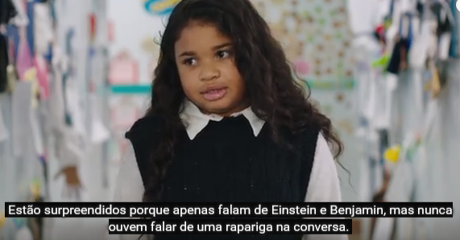



#MAKEWHATSNEXT – Campanha internacional corporativa Microsoft
Em 2015, o Fórum Económico Mundial estimou que a diferença de género nas carreiras não acabará antes de 2133
Notes:
Em 2015, o Fórum Económico Mundial estimou que a diferença de género nas carreiras não acabará antes de 2133. A Microsoft assumiu o compromisso de mudar esta tendência e assim está a conduzir uma campanha corporativa internacional #makewhatsnext (https://www.microsoft.com/en-us/girlsdoscience/ ) que irá culminar em vários eventos por toda a Europa, no próximo dia 28 de abril.

Slide 18
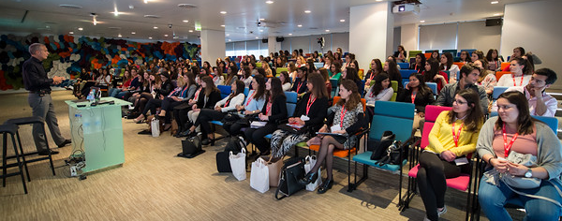
Do IT, girls! – Opportunity to bring together Young women and na industry seen as less atractive for female audience

Slide 19
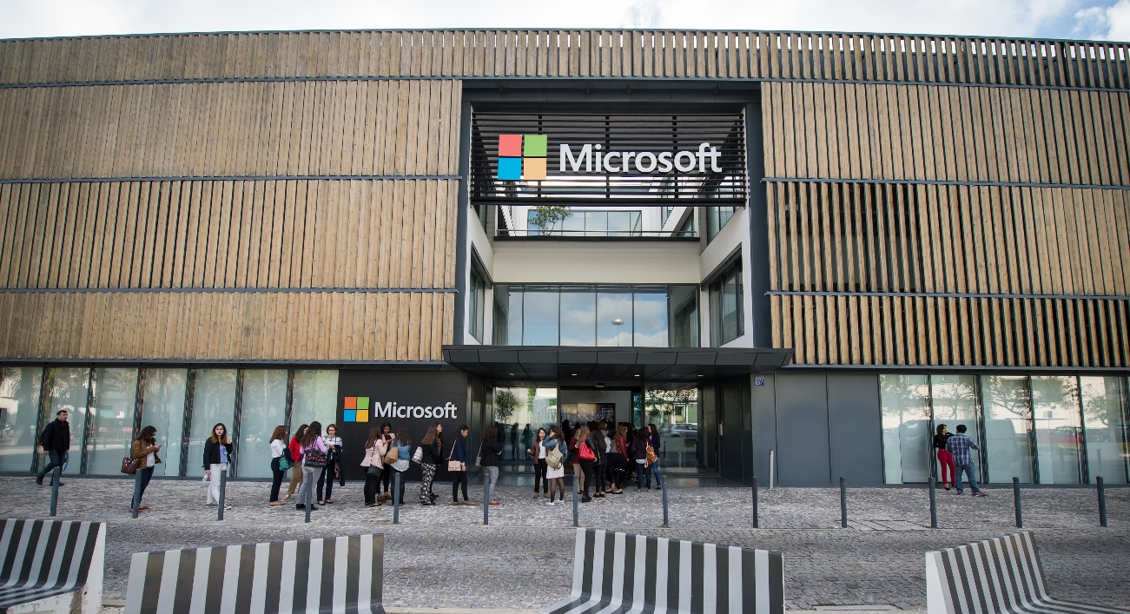
Microsoft Goals
Change the tendence
Train the next generation of women
Show tech industry is for ALL
Identify female talento for Microsoft

Slide 20
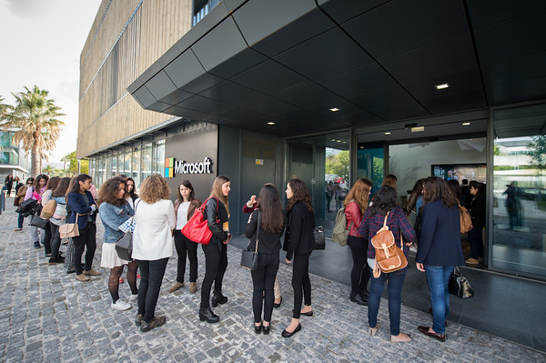
Do IT, girls! - Numbers
Students: 200 university students from different backgrounds
Instituto Superior Técnico | 30%
Faculdade de Ciências e Tecnologia - UNL | 10%
Nova School of Business and Economics | 38%
ISEG | 1%
ISCTE | 5%
Católica Lisbon School of Business and Economics | 10%
IADE | 1%
Universidade de Évora | 1%
Universidade de Coimbra | 1%
Outros | 3%
Total | 100%

Slide 21
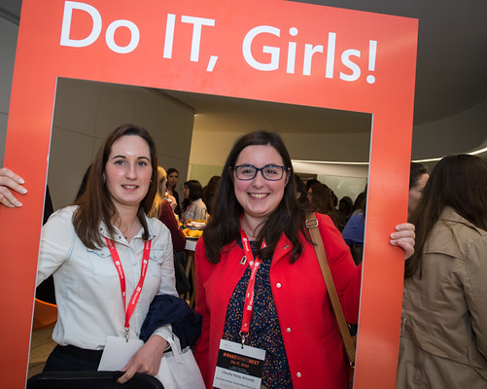
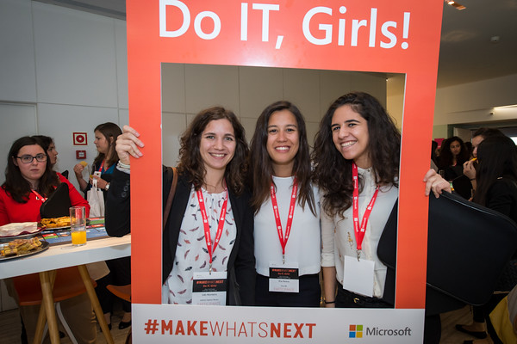
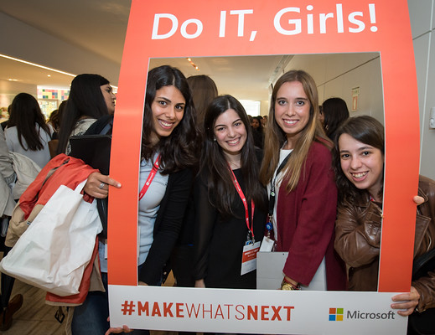
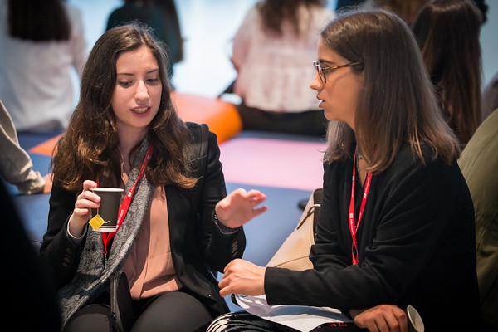
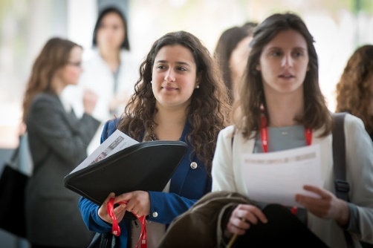
What did we do @ Do IT, Girls? | 28th April

Slide 22
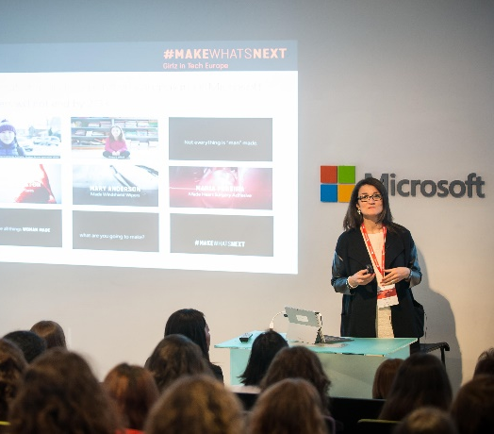
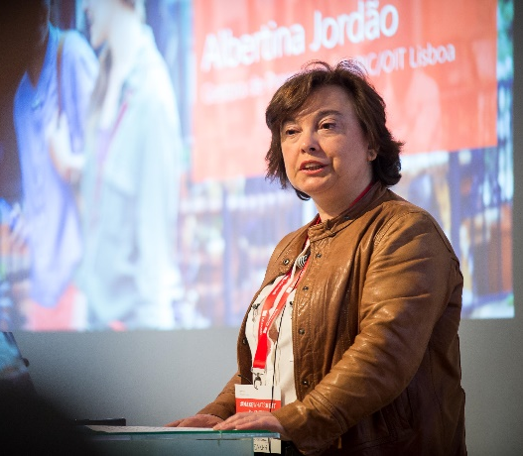
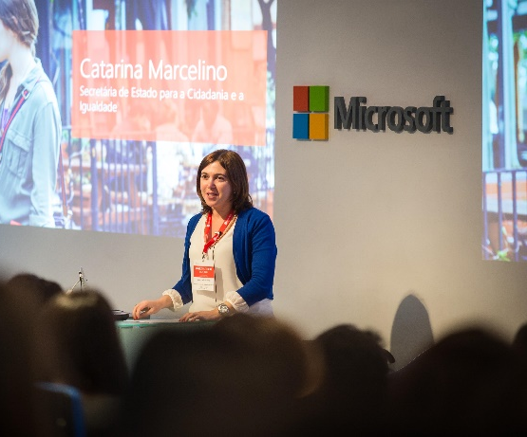
Welcome
Vânia Neto, Education & Citizenship Lead
Albertina Jordão, Program Manager at UNRIC/OIT Lisboa
Catarina Marcelino, Secretary of State of Citizenship and Equality

Slide 23
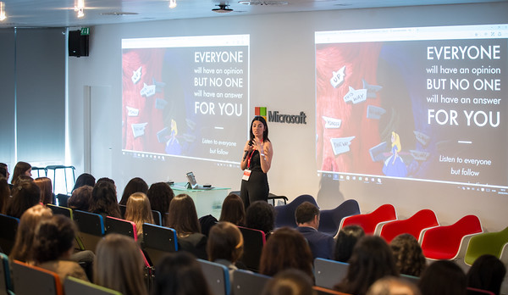

Keynote Speaker
Filipa Neto, Co-founder Chic by Choice.

Slide 24
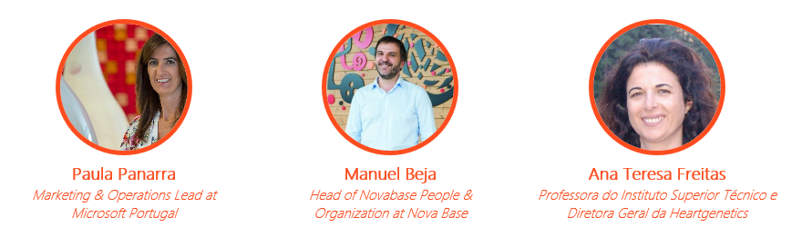
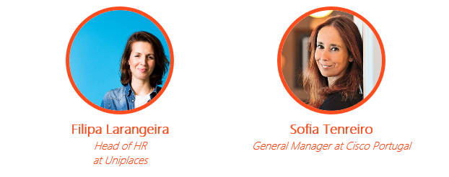
Round table – Do careers have sex?

Slide 25
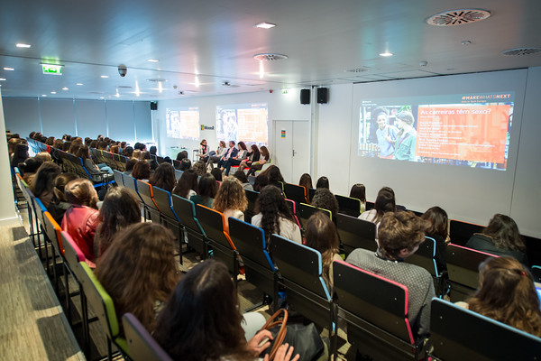
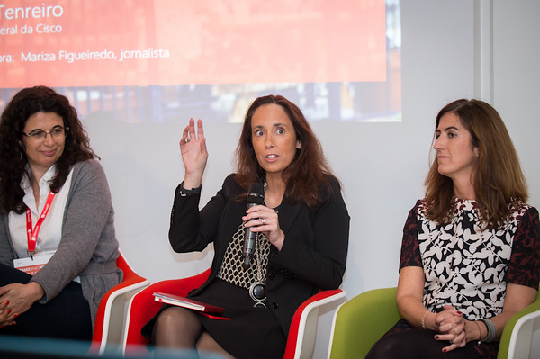
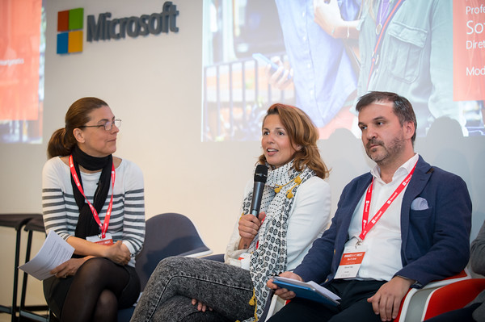

Slide 26

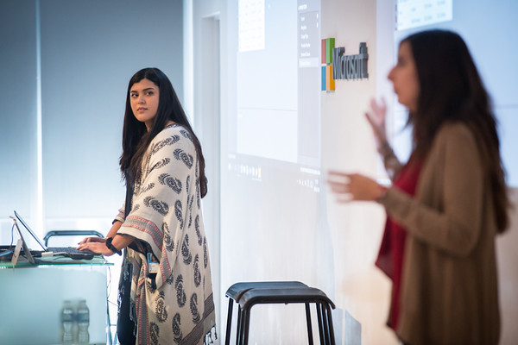
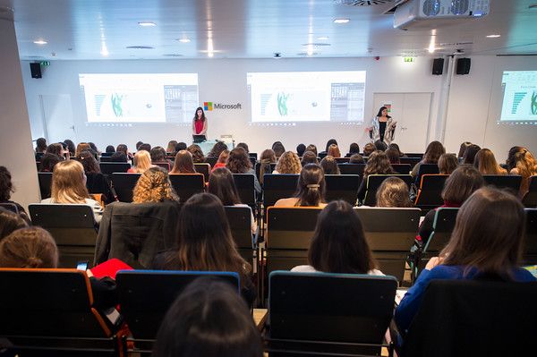
Workshops Digital Skills
Workshop 1:
Power BI
Data analysis in an easy way

Slide 27
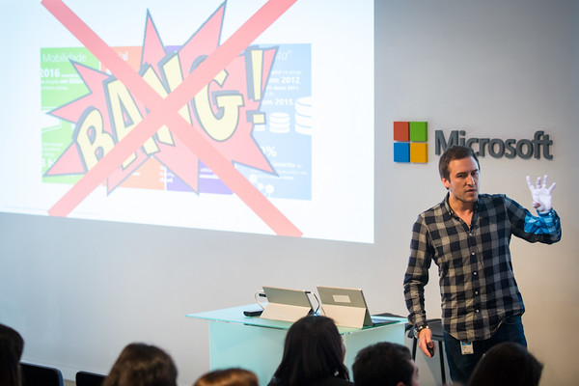
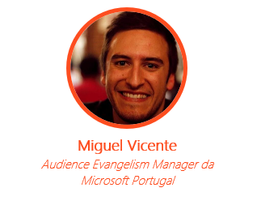
Workshops Digital Skills
Workshop 2:
Present and future of Technology

Slide 28
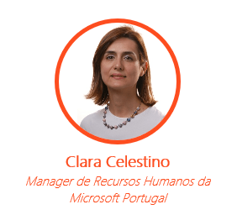
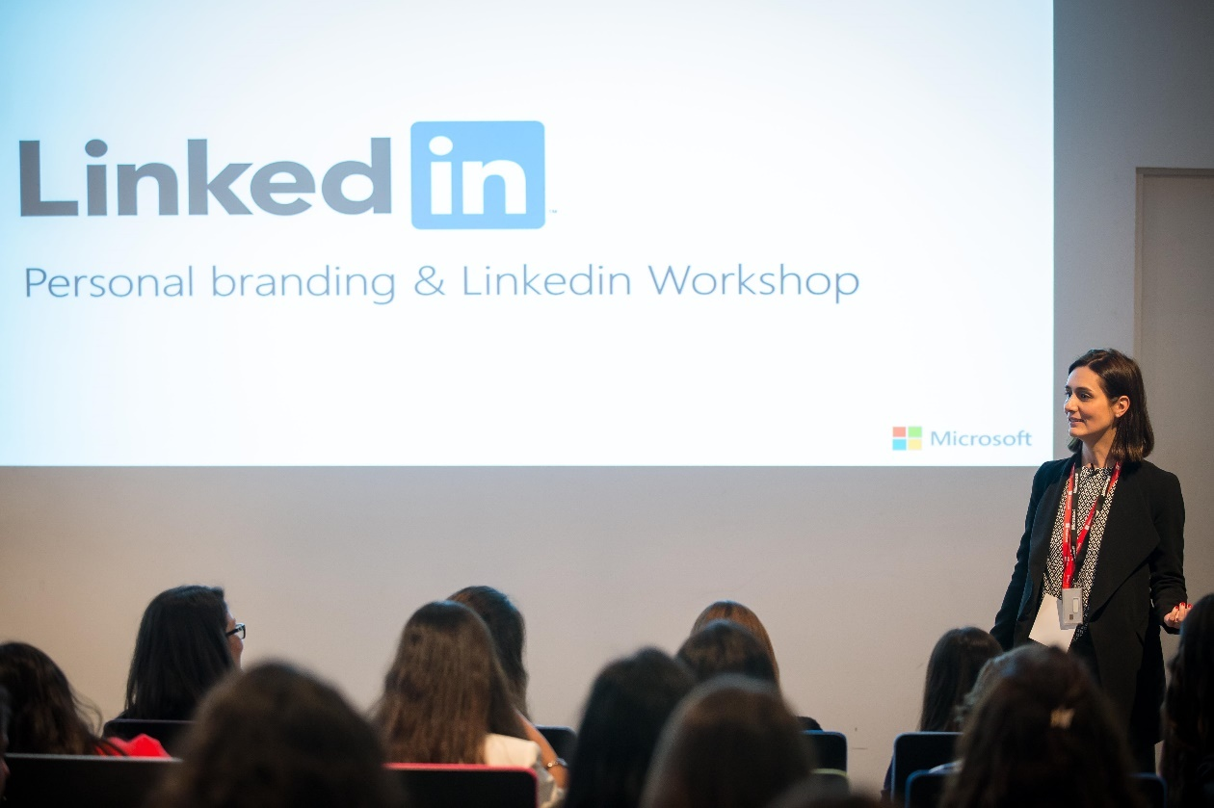
Workshops Digital Skills
Workshop 3:
Personal brand @ Linkedin

Slide 29
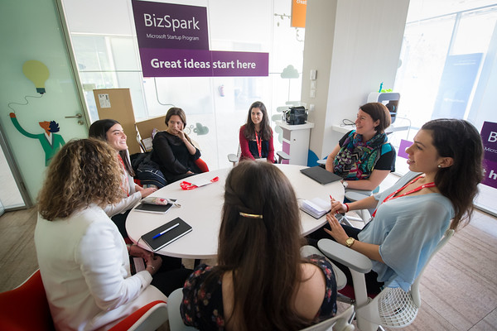
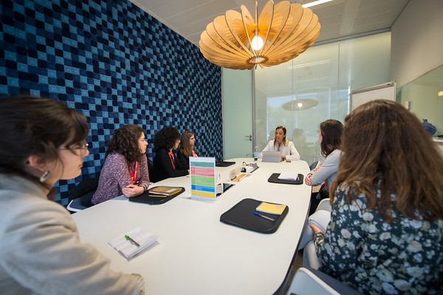
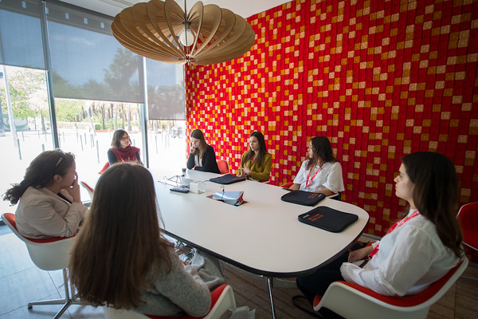
Speed Dating with 20 Mentors Microsoft (Directors and Managers)
Notes:
Objetivos: Exposição dos alunos à Microsoft
Identificação de potencial talent
Partilha de visão e experiências

Slide 30

Opportunities at Microsoft
Young graduates and Young talent programs

Slide 31
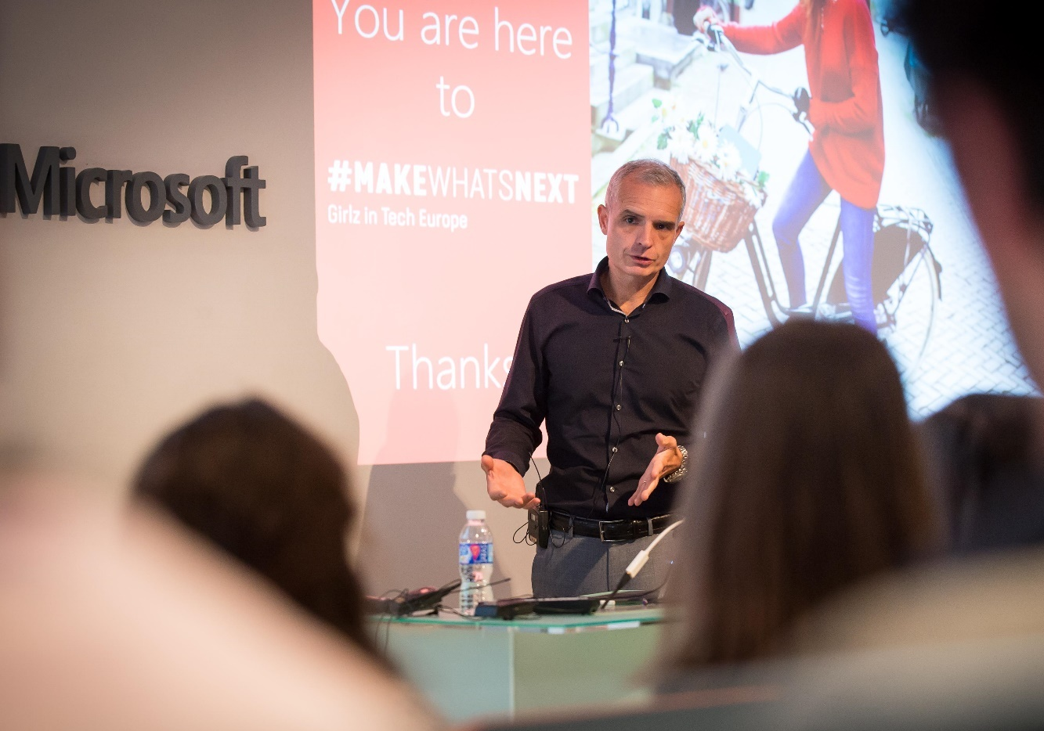
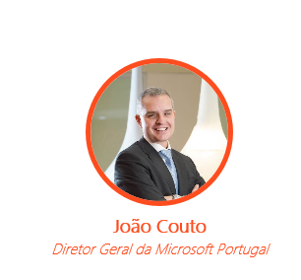
Closing
João Couto faced 200 Young girls to answer all their questions

Slide 32
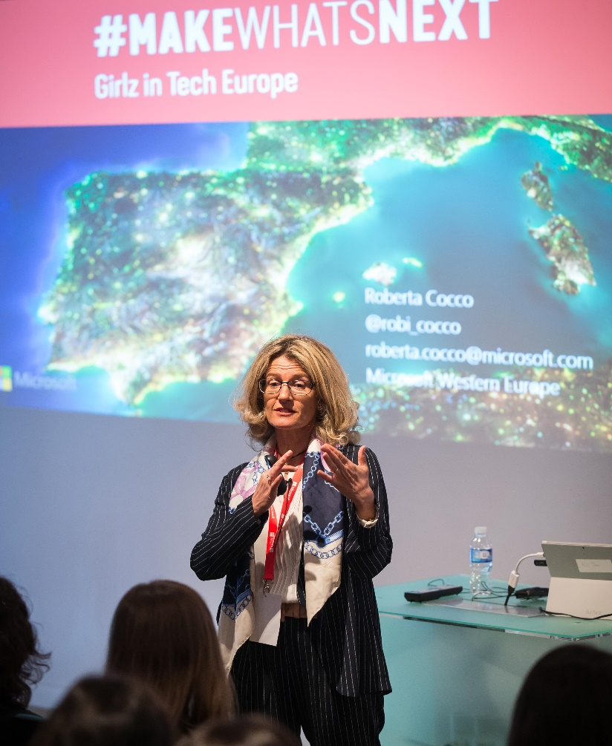
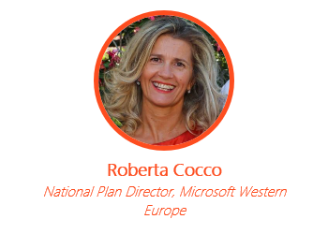
Closing
Roberta Coco, the “soul” of project #MAKEWHATSNEXT
Let’s change the World!

Slide 33


Slide 34
Successful Careers are based on competence.
Not gender.

Slide 35

© 2016 Microsoft Corporation. All rights reserved. Microsoft, Windows, Windows Vista and other product names are or may be registered trademarks and/or trademarks in the U.S. and/or other countries.
The information herein is for informational purposes only and represents the current view of Microsoft Corporation as of the date of this presentation. Because Microsoft must respond to changing market conditions, it should not be interpreted to be a commitment on the part of Microsoft, and Microsoft cannot guarantee the accuracy of any information provided after the date of this presentation. MICROSOFT MAKES NO WARRANTIES, EXPRESS, IMPLIED OR STATUTORY, AS TO THE INFORMATION IN THIS PRESENTATION.

